Slide 1



GREEN DESTINATIONS
BY
RABANA MULLA

Slide 2
1. PROBLEM STATEMENT
Green Destination is a well-known travel agency. The HR Director has recently noticed an increase in employees leaving(attrition). She would figure out any trends or patterns. She has surveyed the staff of Green Destinations and provided the data.
She would like to know the attrition rate (% of people who left the company).
She would also know if factors like age, years at the company and income play a part in determining if people will leave or not.

Slide 3
2.OBJECTIVE
Provide Insights to Hr. Director for employee attrition.
The staff of Green Destinations provided the data.
Create the KPI's accordingly.
Create a dashboard

Slide 4
3. BENIFITS
Cost savings: Reduced revenue means lower recruitment and training costs.
Cultural improvements: A better understanding of the reasons for leaving will help foster a positive work culture.
Enhanced productivity: Lower turnover rates lead to a more stable and productive workforce.

Slide 5
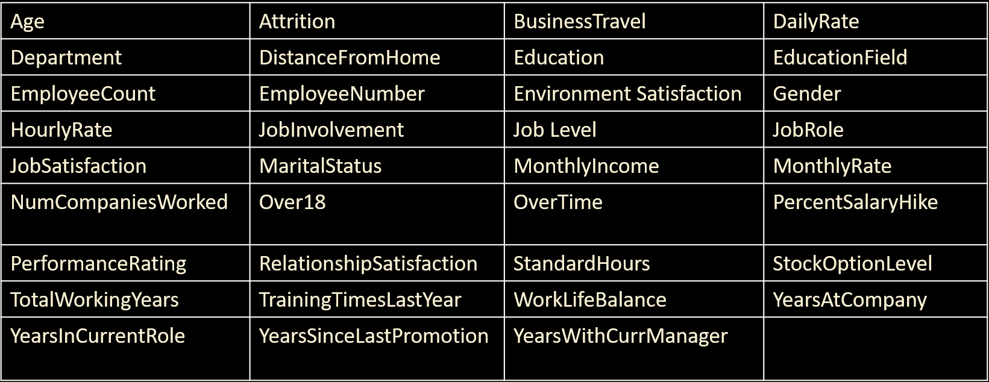
4. DATA ATTRIBUTIES

Slide 6
5. ARCHITECTURE
1. Collect Raw Data - This step involves extracting the data from different sources relevant to the problem statement or obtaining data from the client.
2. Data Wrangling – Contains following steps gathering data, assessing data, handling missing data and adding columns.
3. Exploring Data – Once the data is loaded and pre-processed, we preform data analysis using python libraries and Business Intelligence tools like Tableau public.
4. Deployment - The prepared visualizations are deployed on the public.tableau.com site. Where they will be available publicly.

Slide 7
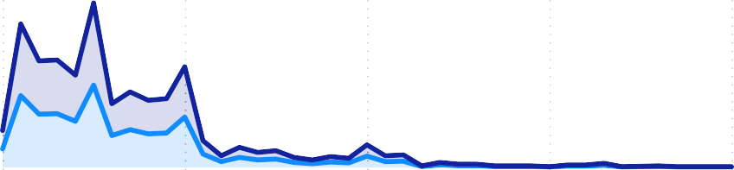
HR Dashboard

Power BI Desktop
Count of Attrition by Gender
Quick measure
Gender
Male
Employee Count
Attrition Count
Active Employee C…
Attrition %
Avg Monthly Income Avg Salary Hike %
6.50K 15.21
Female
1470 237 1233
16.12
0
500
Count of Attrition
1,000
Sum of EmployeeCount and Count of YearsInCurrentRole by
Department by Attrition
Attrition by Job Satisfication Rating
JobRole | 1 | 2 | 3 | 4
Healthcare Representative | 81 | 60 | 137 | 135
Human Resources | 32 | 49 | 42 | 40
Laboratory Technician | 179 | 154 | 234 | 252
Manager | 66 | 67 | 83 | 110
Manufacturing Director | 83 | 103 | 153 | 123
Research Director | 47 | 48 | 85 | 68
Research Scientist | 173 | 169 | 282 | 301
Sales Executive | 216 | 168 | 281 | 354
Sales Representative | 38 | 65 | 85 | 73
Total | 915 | 883 | 1382 | 1456
Sum of EmployeeCount 400
CouYnet oafrYseAarstICnCoumrrenptRaonley
Sales 30.…
Human Re… 4.29%
Sum of EmployeeC…
Department
Research & D…
Sales
Human Reso…
171
196
200
110
196
120
171
80
120
0
80
0
10
20
YearsAtCompany
30
40
Research & … 65.37%
Average of MonthlyIncome by Age
55 54 49 43 59 45 40 44 37
Count of Attrition by Age
13.20K
10.88K
78
50
12.70K
58
10.71K
51
41
8.04K
7.81K
7.70K
7.11K 5.…
Count of Attrition
38
35
29
4.… 4.… 4.…
50
48
56
53
11.56K
52
10.61K
36
34
28
19
47
39
31
32
8
4 5
46
60
26
0
57
42
33
30
24
0
50
11.46K
10.27K
Age

Slide 8
7. KEY PERFORMANCE INDICATOR
Total Employees.
Active Employees.
Attrition Count.
Attrition Rate %.
Average Monthly Income.
Average salary hike %.

Slide 9
8.Recommendations and improvement techniques:
The dashboard provides helpful suggestions to reduce attrition, such as:
Employee engagement program: Implement programs to increase employee engagement and satisfaction.
Career development plans: Yield advancement opportunities and a clear career path.
Compensation and Benefits Evaluation: To remain competitive, compensation and benefits must be evaluated regularly.
Flexible working Arrangements: Offer flexible working arrangements to improve work-life balance

Slide 10
9. CONCLUSION
The HR Attrition Analytics dashboard is a valuable resource for HR professionals and decision-makers seeking to better understand employee attrition. Companies may effectively reduce turnover and establish a stable, engaged, and productive workforce by studying demographic determinants, tracking KPIs, and applying improvement measures. more efficient

Slide 11
Q&A
Q1) What’s the source of data?
➢ The Dataset was taken from Unified Mentor’s Provided Project Description Document.
Q2) What was the type of data?
➢ The data was the combination of numerical and Categorical values.
Q 3) What’s the complete flow you followed in this Project?
➢ Refer Architecture for better Understandings
Q4) What techniques were you using for data?
➢ Removing unwanted attributes
➢ Visualizing relation of independent variables with each other
➢ Cleaning data by removing column with missing values
➢ Converting Numerical data into Categorical values

